Slide 1
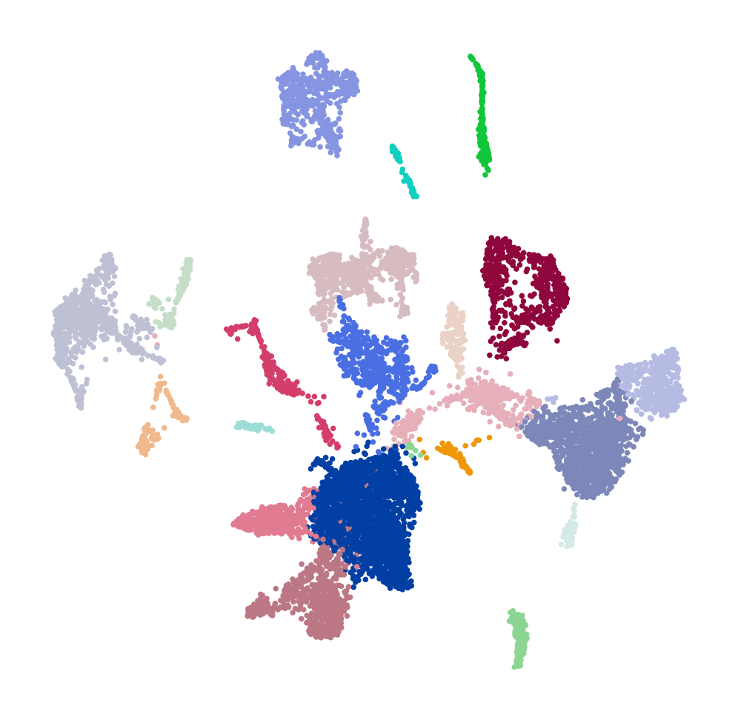

Introduction to scRNAseq Analysis
Jon Preall
Research Associate Professor, CSHL
November 2023

Slide 2
Mapping and Counting
Secondary Analysis
Extract Cell Barcode, UMI, Feature read
Calculate QC metrics
Correct Cell Barcodes
1 hamming distance
Predict doublets
Align to reference with STAR
Filter cells (dead, doublets, outliers)
Assign reads to genes with GTF file
Unique mappers
Normalize & transform (ie. log)
Cellranger / STARsolo / etc
Feature selection (eg. HVG)
UMI correction
1 hamming distance
Cell Ranger or Seurat / Scanpy / Liger etc.
Linear Regression
Collapse UMIs, tally genes/cells
Zero-center & Scale
Raw Gene/Cell Matrix
PCA (Linear Dim. Reduc)
Filter empty droplets, keep cells
(EmptyDrops)
Neighbor Graph
Filtered Gene/Cell Matrix
Clustering (Leiden)
tSNE / UMAP
Differential Expression

Slide 3
Mapping and Counting

Slide 4
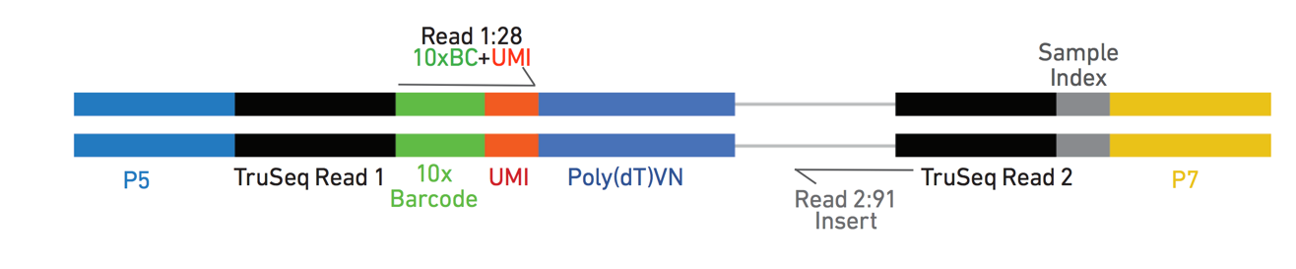
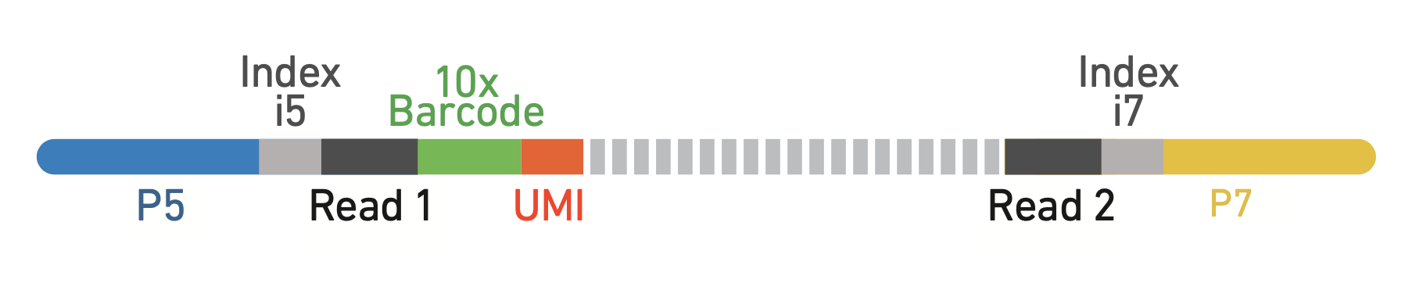
Anatomy of a 10X 3’-Single Cell Amplicon
V3 / NextGem Chemistry
Single Index
12bp UMI
Dual Index

Slide 5
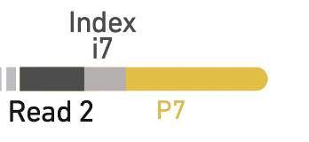
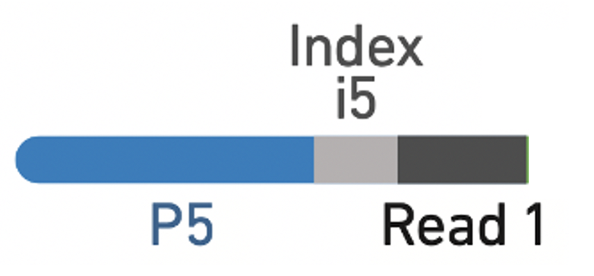
Library Indexing
Single Indexed
GGTTTACT
CTAAACGG
TCGGCGTC
AACCGTAA
SI-GA-A1
8bp
Mix of 4 balanced barcode sequences
Don’t have to worry about how to pool multiple libraries
Susceptible to INDEX HOPPING
i7
TTTCATGA
ACGTCCCT
CGCATGTG
GAAGGAAC
SI-GA-A2
i7
Dual Indexed
i7: GTAACATGCG
i5: AGTGTTACCT
SI-TT-A1
10bp each (20 cycles total)
Fixes index hopping
Pooling with low-plex libraries??
i7: GTGGATCAAA
i5: GCCAACCCTG
SI-TT-A2

Slide 6
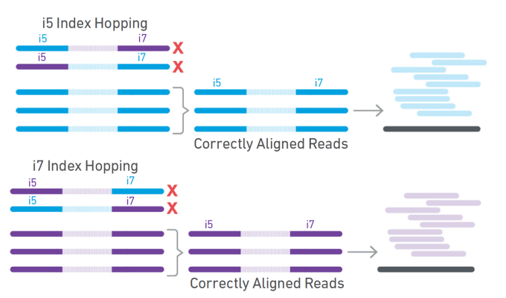
Index Hopping
Multiple mechanisms can cause chimeric molecules to form during amplification
Free adaptors a large culprit
Mainly a problem on patterned flow-cell instruments using ExAmp technology:
NextSeq 2000
NovaSeq
HiSeq 4000
< 1% probability of occurring…
Can have HUGE affect on unique Cell / Barcode / UMI counts!
cellranger mkfastq
index-hopping-filter
Automatically filtered by Cellranger version 4+

Slide 7
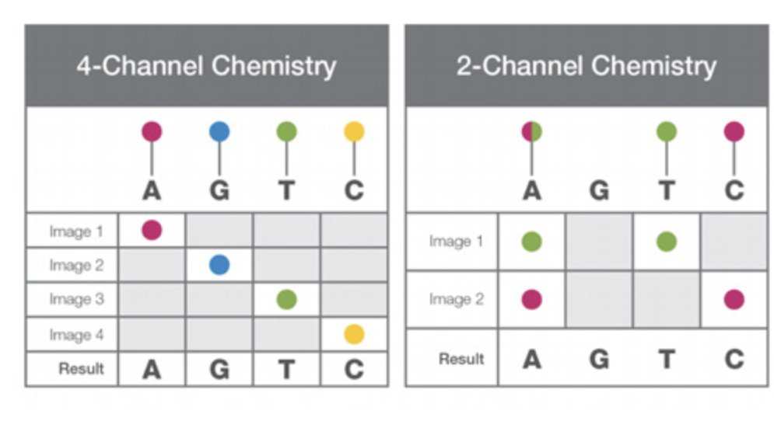
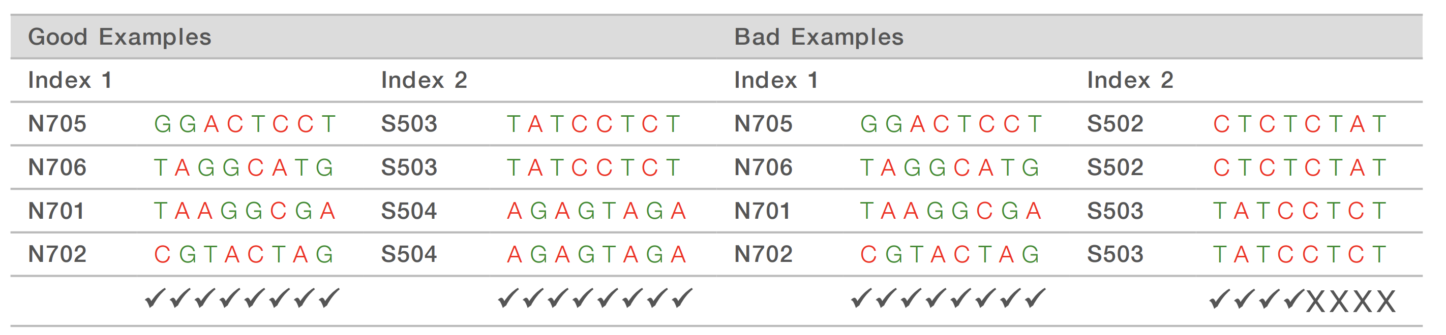
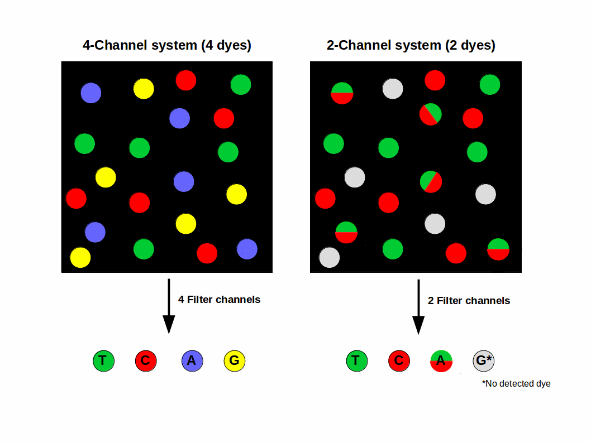
Index Diversity
https://kb.10xgenomics.com/hc/en-us/articles/360045208792-Is-nucleotide-diversity-in-the-index-read-important-for-Illumina-sequencing-
https://support.illumina.com/bulletins/2016/07/what-is-nucleotide-diversity-and-why-is-it-important.html
GOOD
BAD
GG
=
Blank!
Avoid!
Harder to resolve clusters when ALL spots are the same color

Slide 8
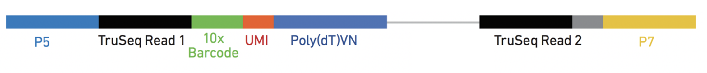
Optimizing your Sequencing run
Instrument |  | Kit Size | Actual Max. Cycle # | Dark Cycles for Dual Index?
NextSeq 500/550 | High Output or Mid Output | 75 | 92 | No
 |  | 150 | 168
NextSeq 1000/2000 | P2 or P3 | 100 | 138 | No
NextSeq 1000/2000 | P2 or P3 | 200 | 238 | No
NovaSeq 6000 | v1 (SP-S4) | 100 | 130 | Yes – 7 cycles
 | v1.5 (SP-S4) | 100 | 138 | No
https://support.illumina.com/bulletins/2016/10/how-many-cycles-of-sbs-chemistry-are-in-my-kit.html
GEX, Single Index
NextSeq 500
75 Cycle kit
28 + … 56 + 8 = 92 cycles
Eg.
10 + 28 + … 90 + 10 = 138 cycles
GEX, Dual Index
NextSeq 2000
100 Cycle kit

Slide 9
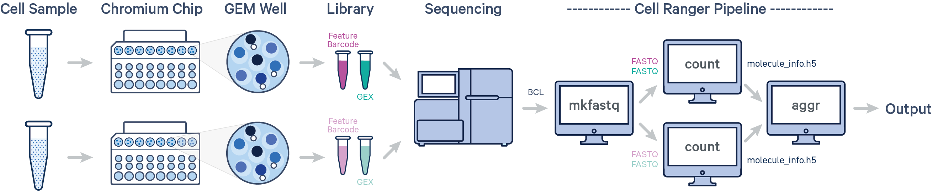
10X Genomics Cell Ranger
Support page: https://support.10xgenomics.com/single-cell-gene-expression/software/pipelines/latest/what-is-cell-ranger
Option 1: Use 10X Genomics Cloud
credits included with reagent purchase
Option 2: Install and run on Linux system:
a. local mode (single computer)
b. cluster mode

Slide 10
Sample Indices
https://www.10xgenomics.com/support/single-cell-gene-expression/documentation/steps/sequencing/sample-index-sets-for-single-cell-3
Dual_Index_Kit_TT_Set_A.csv
# Workflow A = Illumina Forward Strand Sequencing Workflow,,,
# Workflow B = Illumina Reverse Complement Sequencing Workflow,,,
# Please contact www.illumina.com if you are unsure which sequencing workflow your Illumina instrument & Illumina reagent kit uses,,,
index_name,index(i7),index2_workflow_a(i5),index2_workflow_b(i5)
SI-TT-A1,GTAACATGCG,AGTGTTACCT,AGGTAACACT
SI-TT-A2,GTGGATCAAA,GCCAACCCTG,CAGGGTTGGC
SI-TT-A3,CACTACGAAA,TTAGACTGAT,ATCAGTCTAA
SI-TT-A4,CTCTAGCGAG,TATCTTCATC,GATGAAGATA
A
NovaSeq 6000 with v1.0 reagent kits
MiSeq
MiniSeq with Rapid Reagent kits
HiSeq 2500, HiSeq 2000
B
NovaSeq 6000 with v1.5 reagent kits
iSeq 100
MiniSeq with Standard reagent kits
NextSeq Systems
HiSeq X, HiSeq 4000, HiSeq 3000
… only really necessary if you are not using cellranger mkfastq to make FASTQs

Slide 11
Running mkfastq
NOTE: Use 10X’s mkfastq. It plays nicely with 10X libraries and downstream pipelines, unlike the default Illumina mkfastq
cellranger mkfastq \
--localcores=12 \
--run=/path/to/basecalls/ \
--samplesheet=/path/to/SampleSheet.csv \
[Header],,,,,,,
IEMFileVersion,4,,,,,,
Date,5/25/18,,,,,,
Workflow,GenerateFASTQ,,,,,,
Application,NextSeqFASTQOnly,,,,,,
Assay,TruSeqHT,,,,,,
Description,,,,,,,
Chemistry,Amplicon,,,,,,
,,,,,,,
[Reads],,,,,,,
28,,,,,,,
90,,,,,,,
[Settings],,,,,,,
,,,,,,,
[Data],,,:,,,,
Sample_ID,Sample_Name,Sample_Plate,Sample_Well,I7_Index_ID,index,I5_Index_ID,index2,Sample_Project,Description
PlantCourse2022_10xGEX_control,PlantCourse2022_10xGEX_control,,,SI-TT-A9,SI-TT-A9,SI-TT-A9,SI-TT-A9PlantCourse2022,,
PlantCourse2022_10xGEX_treatment,PlantCourse2022_10xGEX_treatment,,,SI-TT-A10,SI-TT-A10,SI-TT-A10,SI-TT-A10,PlantCourse2022,
SampleSheet.csv

Slide 12
What do the FASTQ files look like?
>$ zcat PlantCourse2022_10xGEX_control_S1_L001_I1_001.fastq.gz | head -n 4
@VH00553:6:AAALMHYHV:1:1101:18383:1000 1:N:0:AAGTGGAGAG+GTAACAGGAA
AAGTGGAGAG
+
CCCCCCCCCC
i7 index
>zcat PlantCourse2022_10xGEX_control_S1_L001_I2_001.fastq.gz | head -n 4
@VH00553:6:AAALMHYHV:1:1101:18383:1000 2:N:0:AAGTGGAGAG+GTAACAGGAA
GTAACAGGAA
+
CCCCCCCCCC
i5 index
index_name, index(i7), index2_workflow_a(i5), index2_workflow_b(i5)
SI-TT-A9, AAGTGGAGAG, TTCCTGTTAC, GTAACAGGAA
This was sequenced on a NextSeq, so you can see the i5 read matches workflow b

Slide 13
What do the FASTQ files look like?
Read1
>zcat PlantCourse2022_10xGEX_control_S1_L001_R1_001.fastq.gz | head -n 4
@VH00553:6:AAALMHYHV:1:1101:18383:1000 1:N:0:AAGTGGAGAG+GTAACAGGAA
NGCGTATAGGCTGGATGAAGTTAGTCGG
+
#CCC;CCCCCCCCCCCCCCCCCCCC-CC
Read2
>zcat PlantCourse2022_10xGEX_control_S1_L001_R2_001.fastq.gz | head -n 4
@VH00553:6:AAALMHYHV:1:1101:18383:1000 2:N:0:AAGTGGAGAG+GTAACAGGAA
AAGCAGTGGTATCAACGCAGAGTACATGGCCAAGTACTACCTGGACGACACGGTGGACGTGGTCAAGATGCTGGACGGCCTGGCCAGCGC
+
CCCCCCCCCCCC-CCCCC;CCCCCCC-C;CCC-CCCCCCCCCCCCCCCC-CCCCCCCCCCCCCCCCC-CCCCCCCCCCC;CCCCCCCCC-
Note that the i7 and i5 indices of the associated read are written into the @NAME lines here. This means you don’t really need to worry about keeping, sharing, or depositing the i5 and i7 FASTQ files, as they are basically just “TMI”

Slide 14
Running cellranger count
SAMPLE= SeqTech22_RNA_10k
TRANSCRIPTOME=/path/to/CellRanger/references/refdata-gex-GRCh38-2020-A
FASTQPATH=/path/to/folder/containing/your/fastqs/
cellranger count \
--id=$SAMPLE \
--jobmode=local \
--localcores=12 \
--transcriptome=$TRANSCRIPTOME \
--fastqs=$FASTQPATH \
--sample=$SAMPLE \
--include-introns=false
Note: If you sequenced your library more than once on different flow cells, Cellranger will accept a comma-separated list of paths to each FASTQ folder
FASTQPATH=/path/to/fastq/folder1/,/path/to/fastq/folder2/

Slide 15
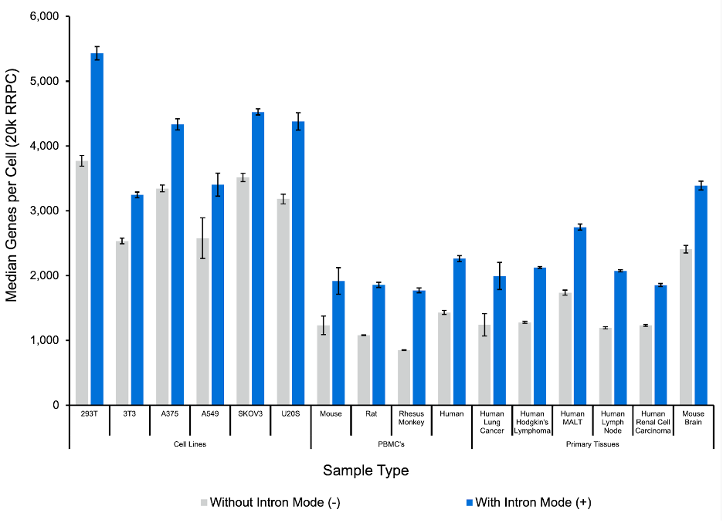
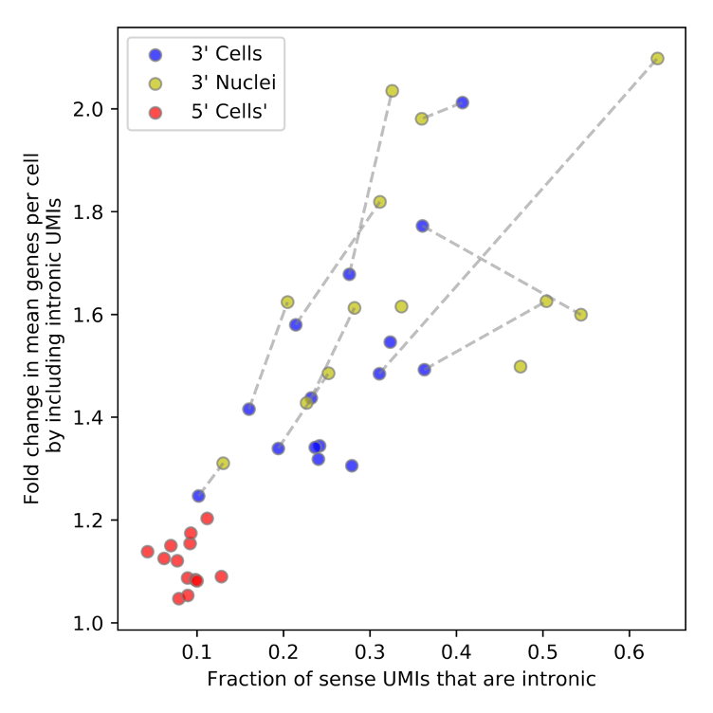
--include-introns …?
Should intronic reads be counted toward UMI counts?
Single nucleus RNAseq:
YES (duh).
Single cell RNAseq:
Debatable.
More UMIs, but less comparable to legacy datasets
Default Behavior:
Pre-Cell Ranger 7:
--include-introns=False
Cell Ranger 7+
--include-introns=True
https://kb.10xgenomics.com/hc/en-us/articles/4998628924429-Why-should-I-include-introns-for-my-single-cell-whole-transcriptome-Gene-Expression-data-analysis-

Slide 16
Alternative Aligners
STARsolo: https://github.com/alexdobin/STAR/
scumi: https://bitbucket.org/jerry00/scumi-dev/src/master/
kallisto bustools: https://www.kallistobus.tools/
Pseudoalignment
Alevin (salmon) https://salmon.readthedocs.io/en/latest/alevin.html
Alevin-fry https://github.com/COMBINE-lab/alevin-fry

Slide 17
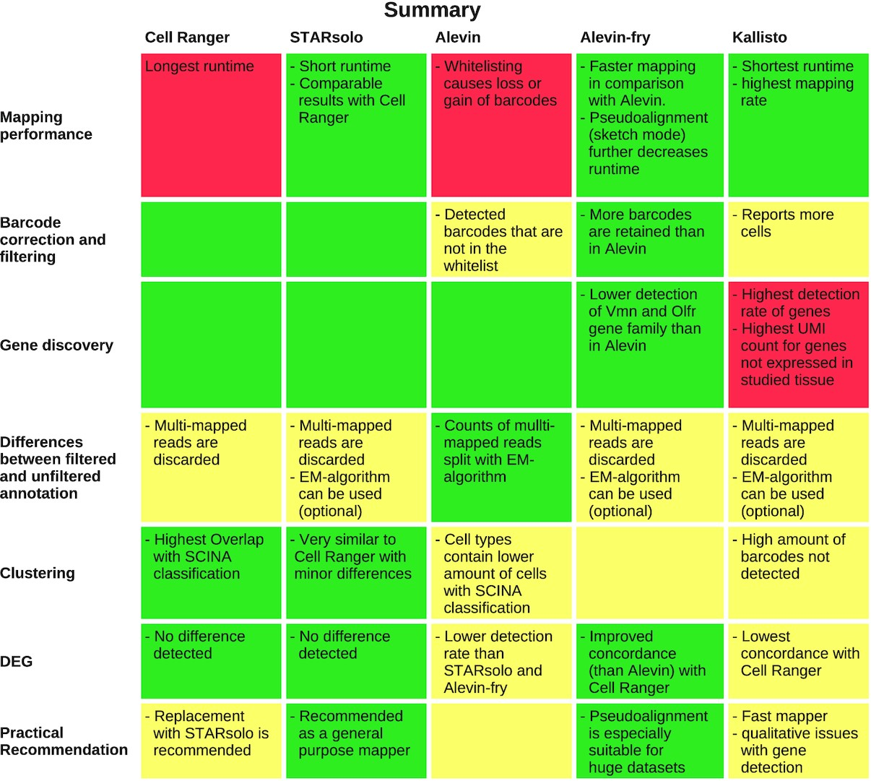

Notes:
Figure 5: Summary of the results for each evaluated section of interest and mapper. Good results are coloured in green, intermediate in yellow, and poor results in red.
Unless provided in the caption above, the following copyright applies to the content of this slide: © The Author(s) 2022. Published by Oxford University Press GigaScience.This is an Open Access article distributed under the terms of the Creative Commons Attribution License (https://creativecommons.org/licenses/by/4.0/), which permits unrestricted reuse, distribution, and reproduction in any medium, provided the original work is properly cited.© The Author(s) 2022. Published by Oxford University Press GigaScience.

Slide 18
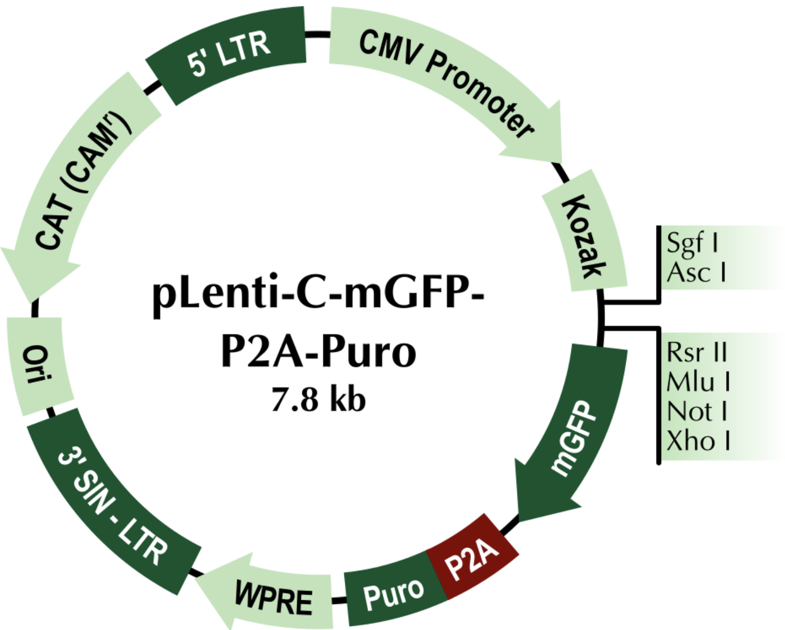
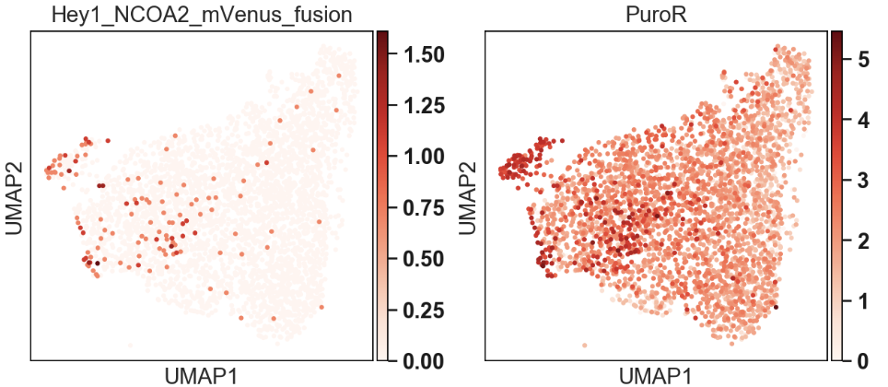
Custom Genomes w/ cellranger mkref
https://support.10xgenomics.com/single-cell-gene-expression/software/pipelines/latest/advanced/references
10X Provides Prebuilt references for:
Human (hg19 and GRCh38)
Mouse (mm9 and mm10)
Why do I need a new reference genome?
Expanded annotations (eg. GENCODE, ncRNAs, etc.)
Additional species (eg. Maize)
Monitoring custom transgenes
Viruses, pathogens
known rearrangements, model specific genomes
unconventional gene annotations
What do I need?:
Genome FASTA file
GTF file containing feature coordinates
mVenus fusion transgene

Slide 19
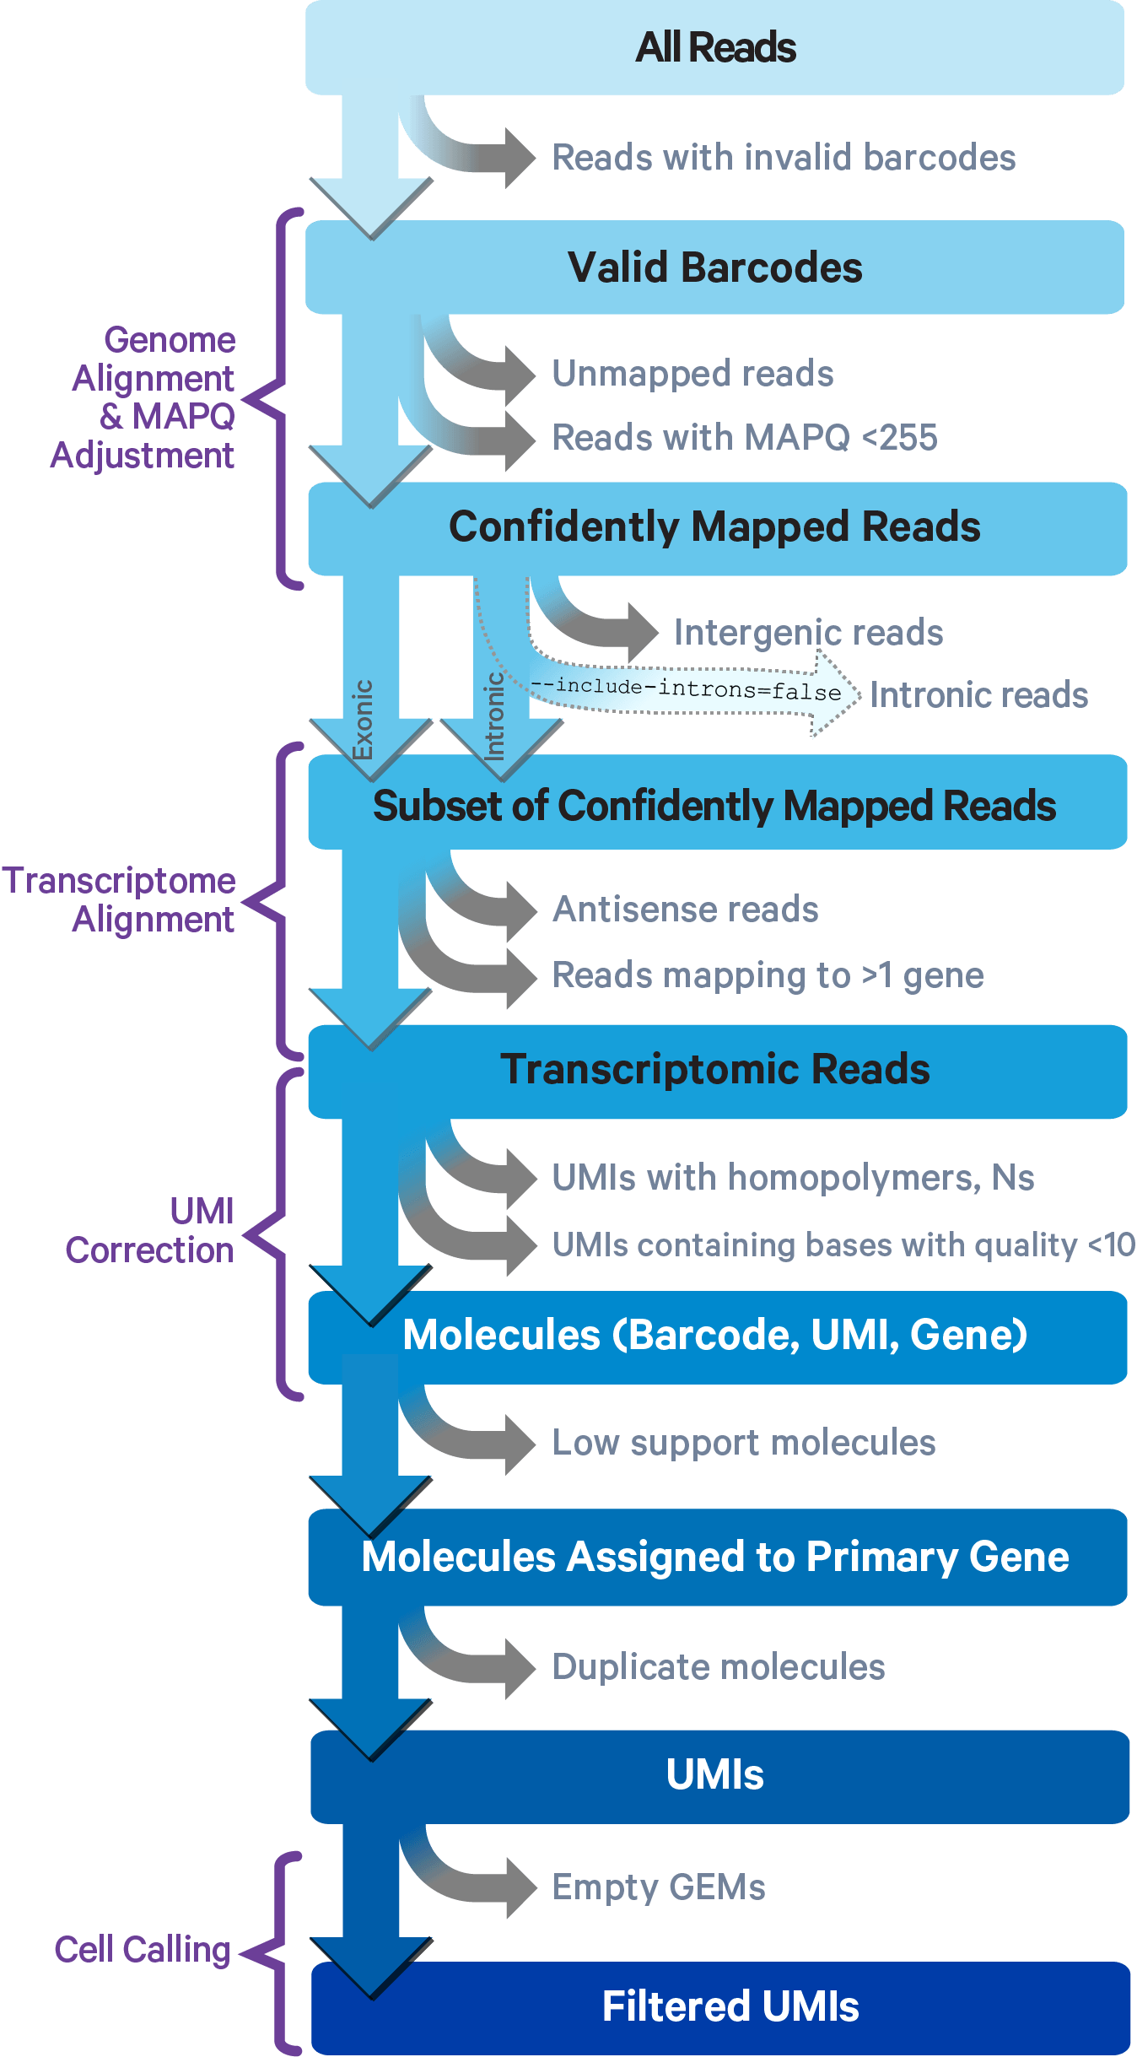
Overview of cellranger count
“Secondary Analysis”
Dimensionality reduction, clustering, etc

Slide 20
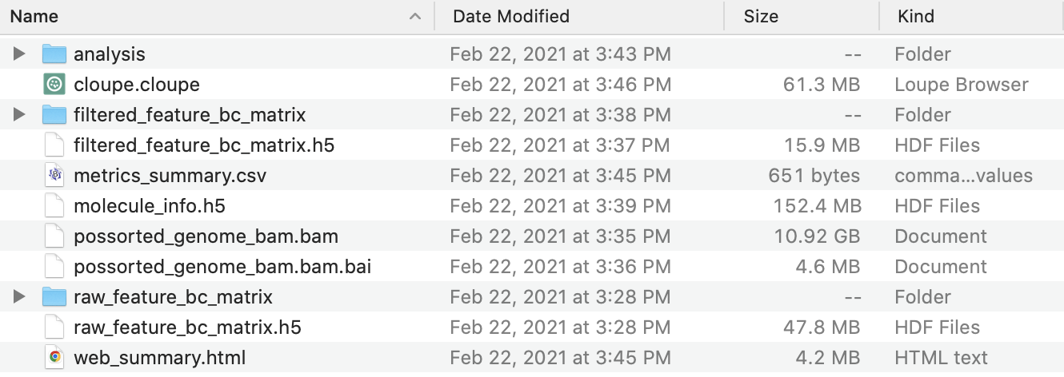
Cell Ranger Pipeline Output
Highly
Processed
Raw
FASTQ
/seq/Illumina_runs/NextSeqData/NextSeqOutput/181221_NB551387_0127_AHHL52BGX9/HHL52BGX9/outs/fastq_path
Note: 10X has a bamtofastq tool that can reconstruct a publishable, lossless FASTQ directly from the mapping output bam file

Slide 21
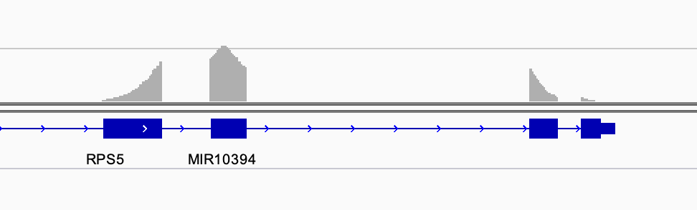
BAM file You should Archive this.
(base) [jpreall@bamdev2 outs]$ samtools view possorted_genome_bam.bam | head -n 1
NB501555:883:HKHCNBGXH:1:13203:17140:14586 16 1 3000079 255 56M * 0 0 AAACCATTTGGTCCCTTTCTTTTTTTTTTTTTTTTTTTTTTTTTTGGGTGGGAGAC EE//A//////////////6EEEEEEEEEEEEEEEEEEEEEEEEEEEEEEEAAAAA NH:i:1 HI:i:1 AS:i:43 nM:i:6 RG:Z:Vakoc_YH02_trachea:0:1:HKHCNBGXH:1 RE:A:I xf:i:0 CR:Z:AGCTTCCTCTTCCCGA CY:Z:AAAAAEEEEEEEEEEE CB:Z:AGCTTCCTCTTCCCGA-1 UR:Z:AGTTATTCCCAA UY:Z:EEEEEEEEEEEE UB:Z:AGTTATTCCCAA
Stores alignment features, cell barcode, overlapping genes, UMI
Contains complete record of sequencing data
FASTQs can be faithfully recreated (eg. for publication) using bam2fastq
Can be viewed as a browser track
Can be be used to extract per-cell genotype / allelic expression using Vartrix

Slide 22
Which Cell Ranger pipeline to use?
Library type | Cell Ranger pipeline
3/5' Gene Expression | count
3' Targeted Gene Expression | count
3/5' Gene Expression + Antibody/CRISPR Guide Capture | count
Antibody Capture only | count
3/5' Gene Expression + Cell Multiplexing (+ Antibody/CRISPR Guide Capture) | multi
Fixed RNA Profiling Gene Expression (+ Antibody Capture) | multi
ATAC | atac
RNA + ATAC Multiome | arc

Slide 23
Secondary Analysis
Calculate QC metrics
Must use
3rd-party tools:
Eg.
Seurat
Scanpy
Liger
Pegasus
scUMI
Predict doublets
Cell Ranger
Filter cells (dead, doublets, outliers)
Normalize & transform (ie. log)
Feature selection (eg. HVG)
Linear Regr. / Batch Corr.
Zero-center & Scale
PCA (Linear Dim. Reduc)
Neighbor Graph
Clustering (Leiden)
tSNE / UMAP
Differential Expression

Slide 24
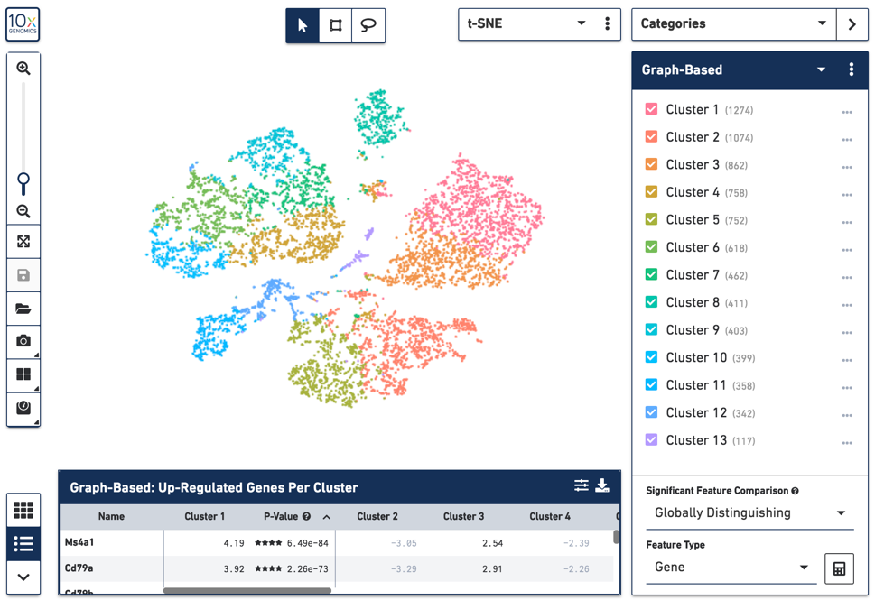
Loupe Browser
Can:
Quickly visualize genes
Do guided clustering via marker genes / tSNE selections
Calculate Differential Expression
Export cells and gene sets for reanalysis on Cellranger (cluster)
Can’t
Compute & track composite features (eg. %mito, cell cycle)
Perform linear regression
Filter Doublets
Properly batch correct
Pseudotime, other fancy things
Tutorial:
https://support.10xgenomics.com/single-cell-gene-expression/software/visualization/latest/tutorial

Slide 25
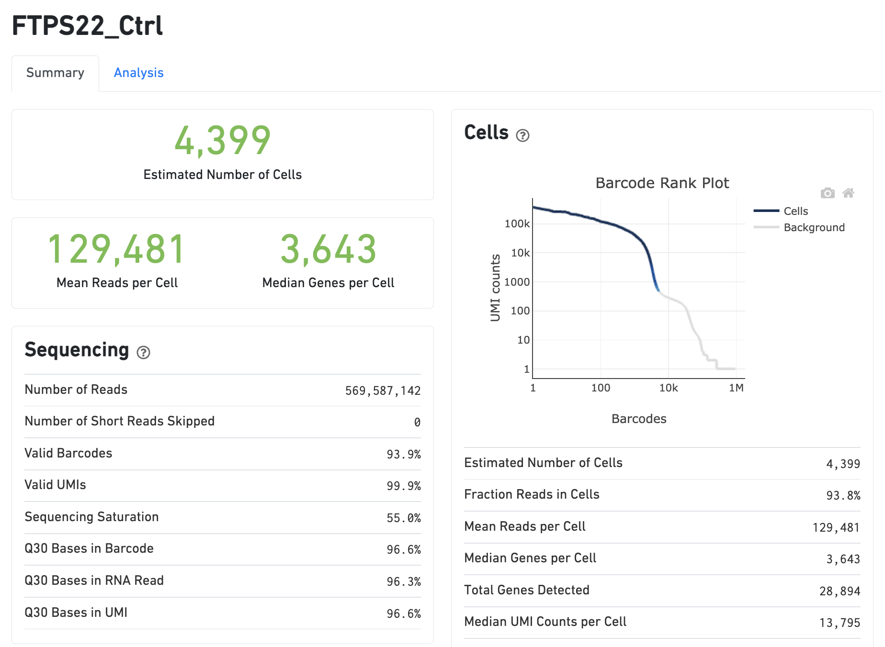
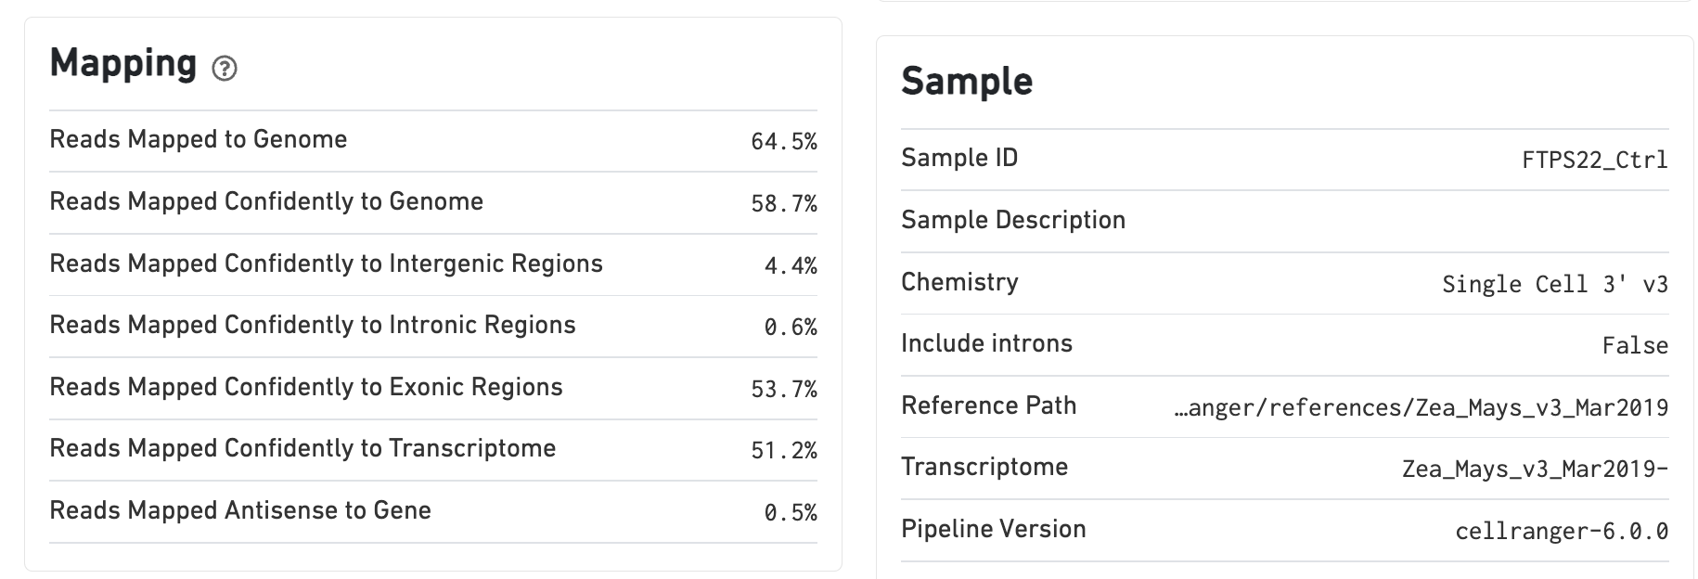
Quality Control: web_summary.html

Slide 26
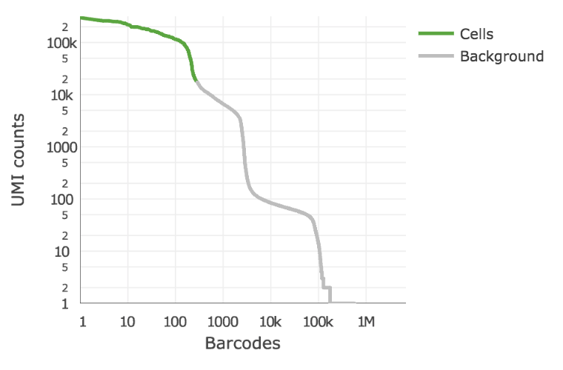
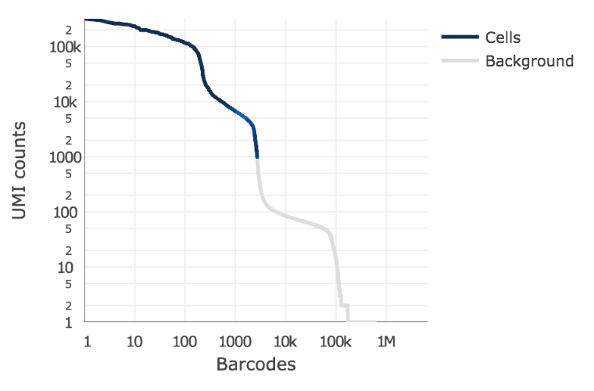
Cell Calling Algorithm
Based on EmptyDrops
https://genomebiology.biomedcentral.com/articles/10.1186/s13059-019-1662-y
Low-UMI cells
(eg. T-cells)
Likely
empty
Cellranger 2
Cellranger 3+
Inflection point of knee plot
Missed Low-UMI cell types
Compares each barcode with likely empty droplets
Much more permissive – keeps dead cells any anything remotely “cellish”

Slide 27
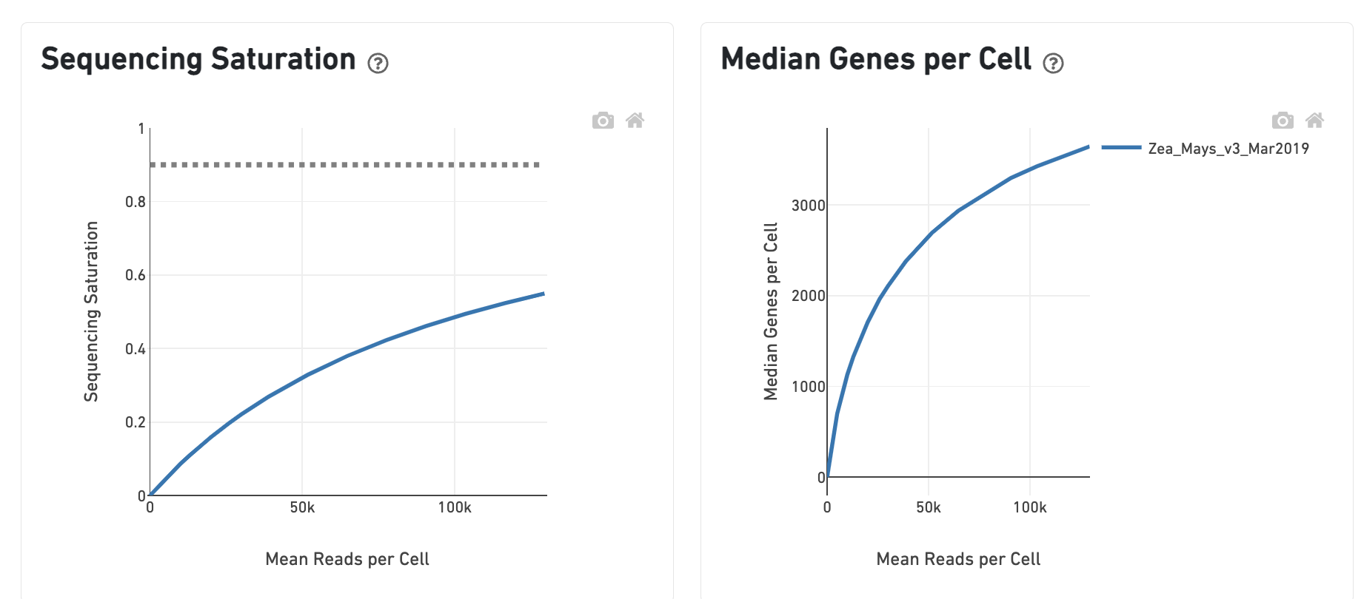
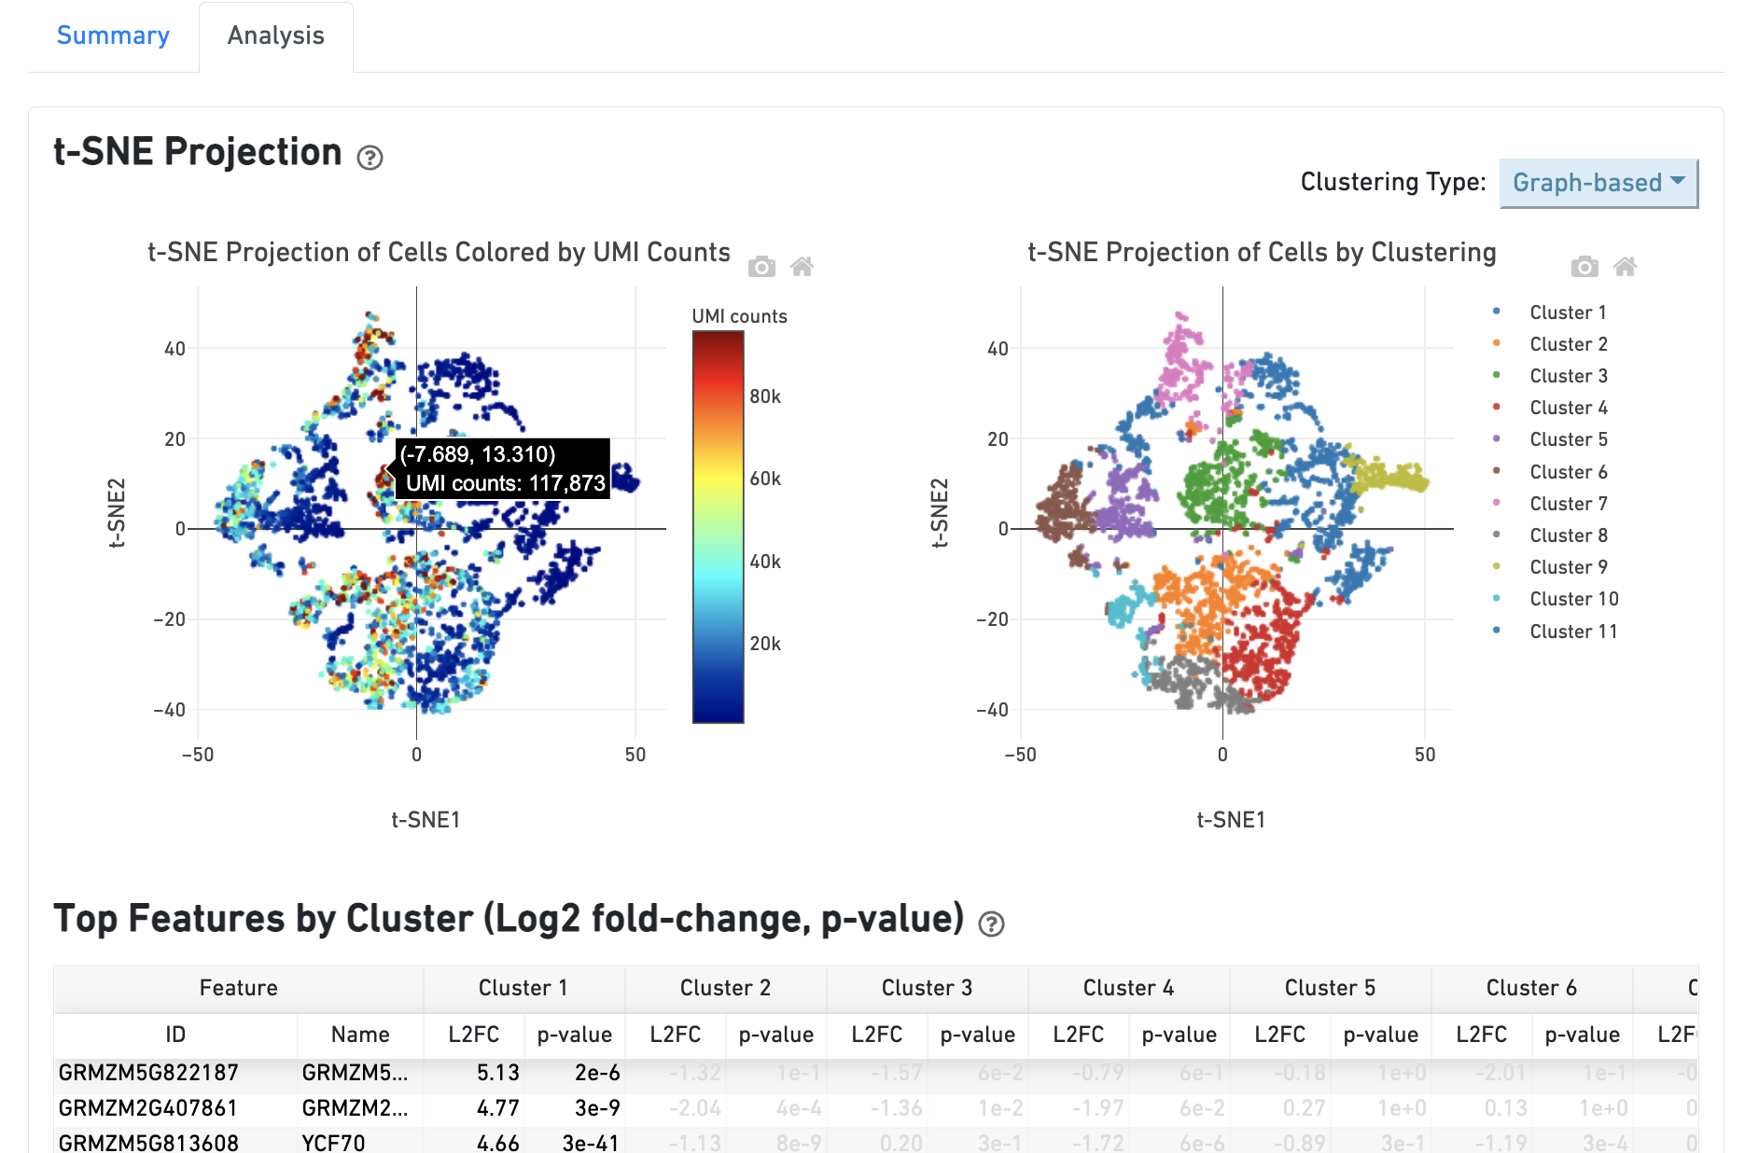
Quality Control: web_summary.html

Slide 28
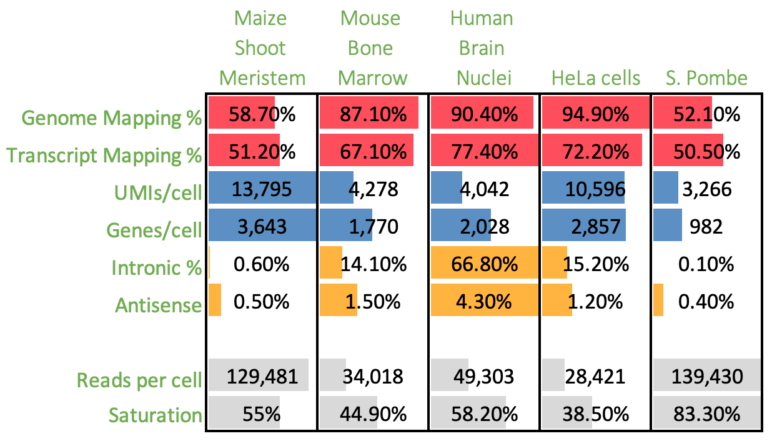

Putting up the numbers

Slide 29
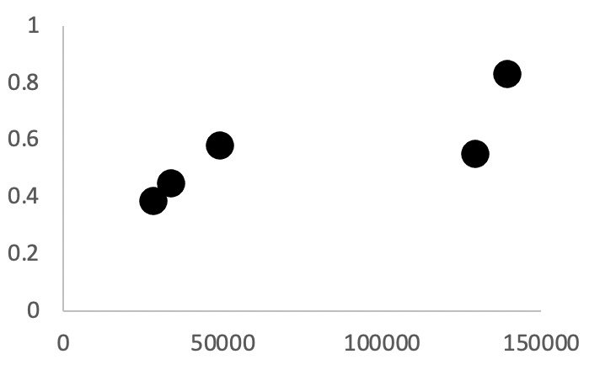
Samples saturate at different rates
Function of:
Sample Composition:
# of cells
# of UMIs/cell
Library Quality:
PCR duplication
Adapter dimers
Contaminating DNA (mapping rate)
Pombe
Mouse
Bone Mar.
Human Brain
Nuclei
Sequencing Saturation
Maize Shoot
HeLa
Reads per cell

Slide 30
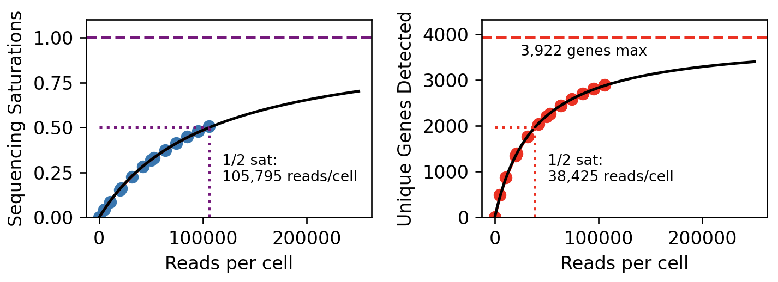
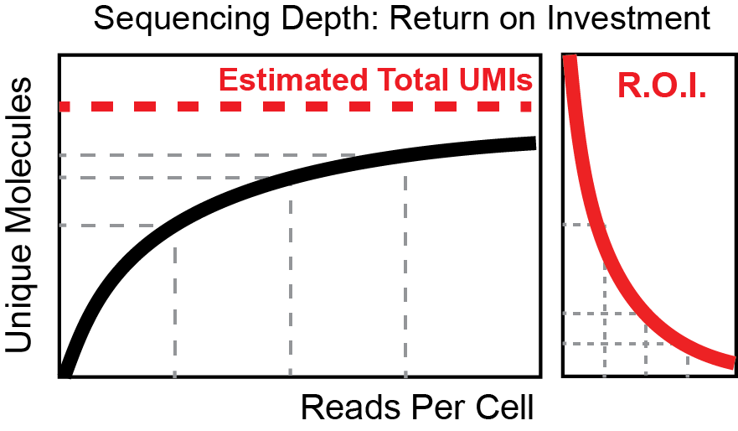
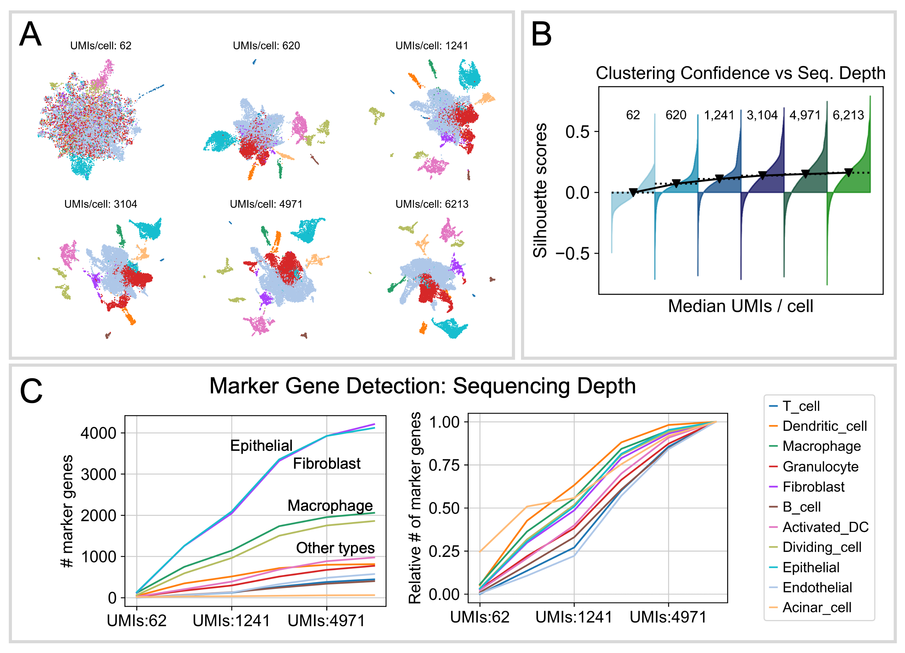
Sequencing Saturation – How deep?
Regan and Preall, Current Protocols, 2022

Slide 31
Combine samples with cellranger aggr
First, make an aggr.csv file
sample_id,molecule_h5
SeqTech22_RNA_10k,/fake/path/SeqTech22/count/SeqTech22_RNA_10k/outs/molecule_info.h5
SeqTech22_RNA_12k,/fake/path/SeqTech22/count/SeqTech22_RNA_12k/outs/molecule_info.h5
PROJECTDIR=/fake/path/SeqTech22/
cellranger aggr --id=SeqTech \
--jobmode=local \
--csv=$PROJECTDIR/aggr.csv \
--normalize=none \ # or –-normalize=mapped
--localcores=16 \
--localmem=64
--normalize=mapped will subsample reads from higher-depth libraries until all have roughly similar numbers of reads per cell. It isn’t frequently used in publications. Rather, try your best to just sequence all samples to the same depth.
--normalize=none simply concatemerizes the two matrices together, and gives each samples a unique barcode suffix, in the order they appear in the aggr.csv file (-1, -2, -3, etc)

Slide 32
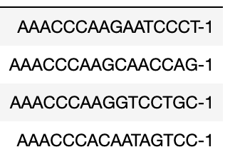
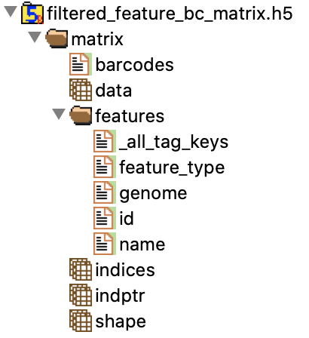
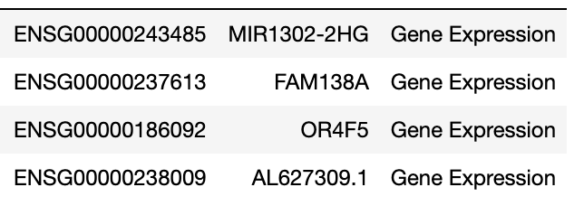
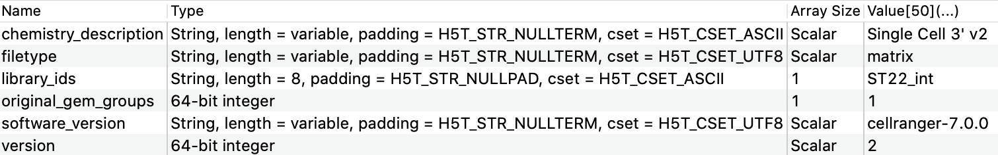
Matrix format: HDF5 vs MTX (MEX)
Market Exchange (MEX) Format
Hierarchical Data Format 5 (HDF5)
Simple, deprecation-resistant
Slow, lazy about metadata
Fast, stashes arbitrary data/metadata
Require software to open – vulnerable to bit rot
barcodes.tsv
Both store data in SPARSE format
features.tsv
%%MatrixMarket matrix coordinate integer general
%metadata_json: {"software_version": "cellranger-6.0.0", "format_version": 2}
36601 4500 13943571
24 1 5
49 1 1
54 1 1
58 1 1
60 1 4
63 1 7
72 1 2
matrix.mtx
Metadata!

Slide 33
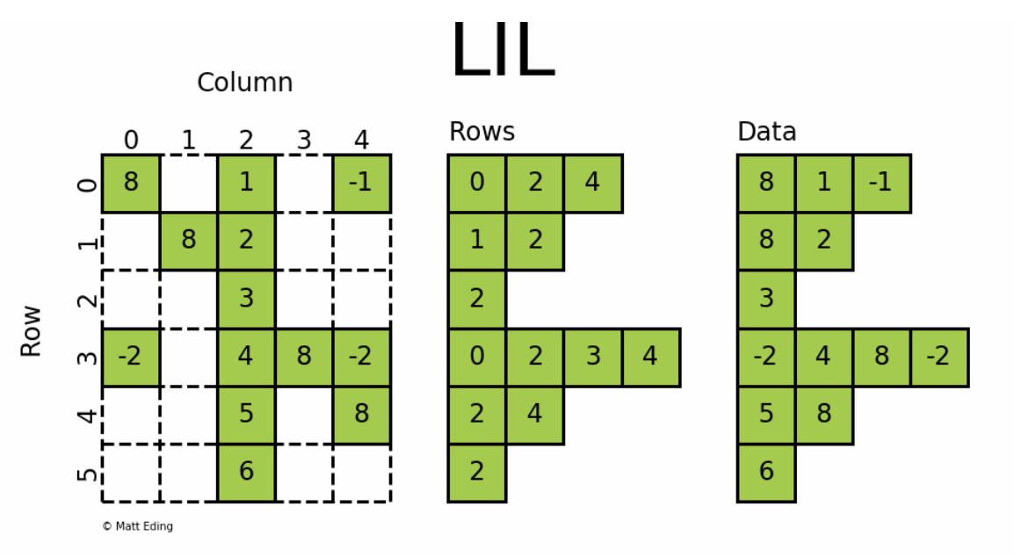
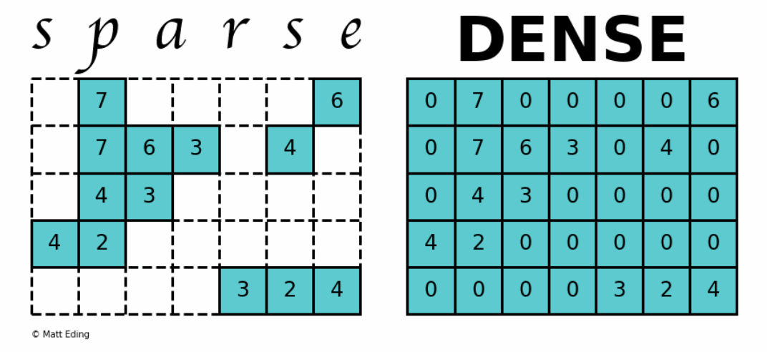
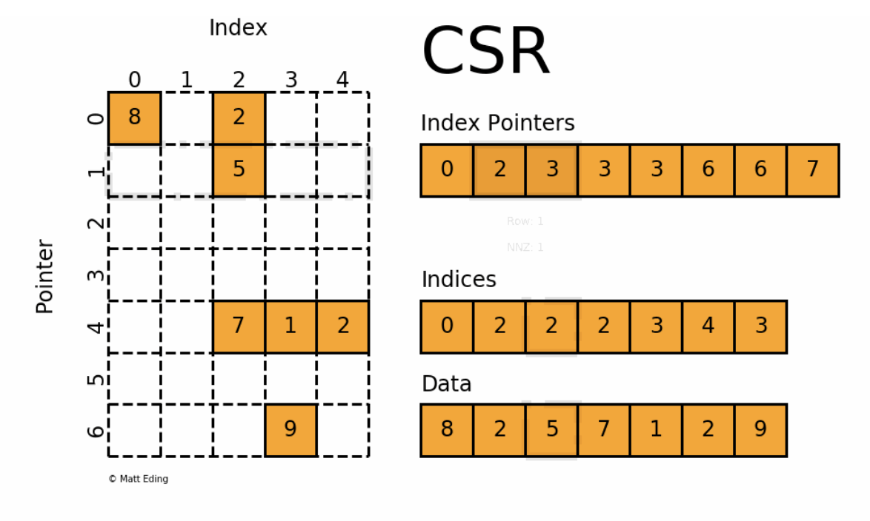
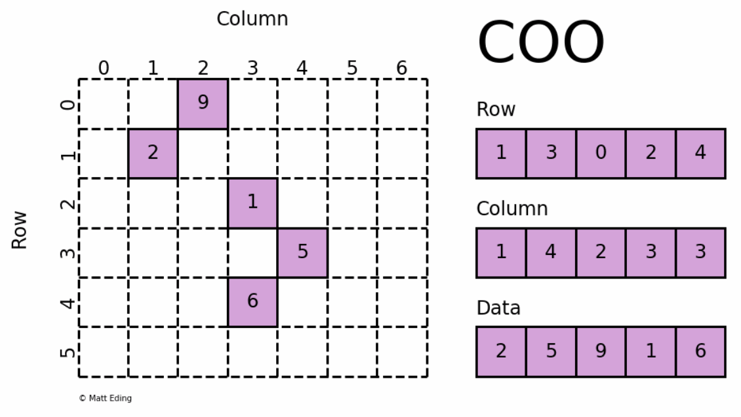
Sparse vs Dense Matrices
Different ways to encode sparse matrices
Use packages like scipy.sparse
Each encoding is optimized for different types of computations, memory usage, I/O, etc
https://matteding.github.io/2019/04/25/sparse-matrices/

Slide 34

Calculate QC metrics
A-
Predict doublets
F
Cell Ranger’s Report Card
Filter cells (dead, doublets, outliers)
F
Normalize & transform (ie. log)
B
Batch Correction
D
Feature selection (eg. HVG)
D
Regress unwated variation
F
Cell Type Identification
F
PCA (Linear Dim. Reduc)
A
Sharing Data with Biologist Colleages
A++
Neighbor Graph
A
Clustering (Leiden)
B
Quickly visualizing markers
A++
tSNE / UMAP
A
Quickly finding diffex. genes
A-
Differential Expression
B+

Slide 35
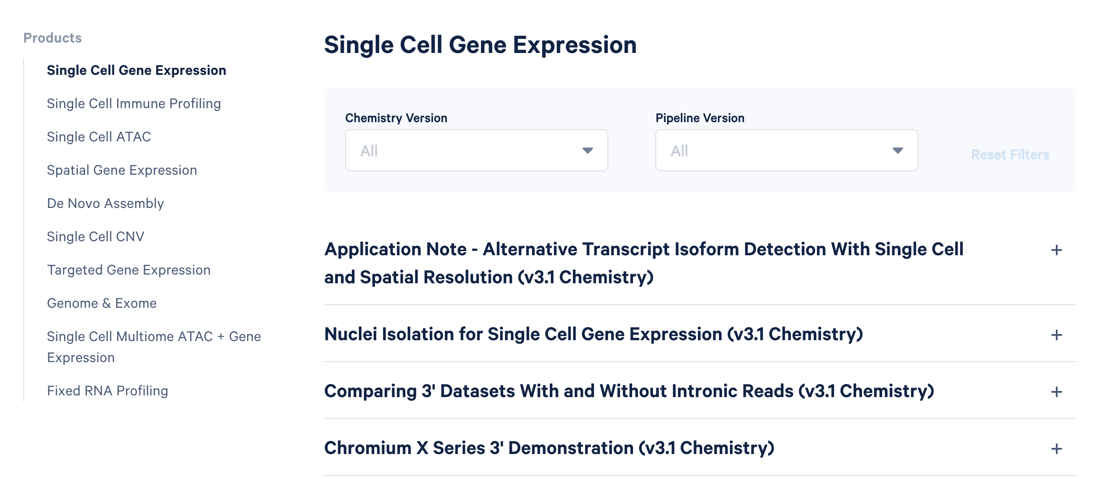
Demo Datasets
https://www.10xgenomics.com/resources/datasets

Slide 36
EXERCISE 1
Interactively explore a PBMC dataset from SeqTech 2017
https://www.dropbox.com/sh/qksaunln69yrqd1/AAAKLZ4E-yyfhb5-eYSnvnnZa?dl=0

Slide 37
EXERCISE 2
Step 1: Export the category 'Protospacer Per Tag' using Loupe Browser
Step 2: Modify the CSV file to collapse sgRNAs by gene target.
eg. merge ACE2-1 and ACE2-2 into a single category, 'ACE2'
Step 3: Import back into Loupe and run differential expression on sgRNAs

Slide 38




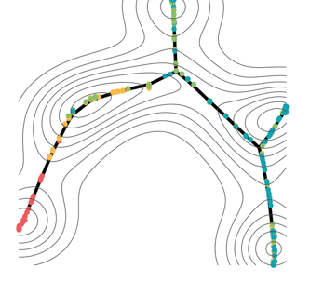
Secondary Analysis
Fabian Theis - München
R
Liger
R
https://scanpy.readthedocs.io/en/latest/
Python
Macosko lab
Cole Trapnell –WashU

Slide 39
QC metrics – Cell Death
Filter cells by Fraction Mitochondrial Reads
Healthy Cell
1,142 cells
Fraction Mitochondrial
mRNA
Mitochondrion
20,283 cells
Dying / Ruptured Cell

Slide 40
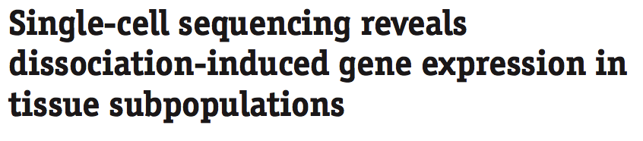
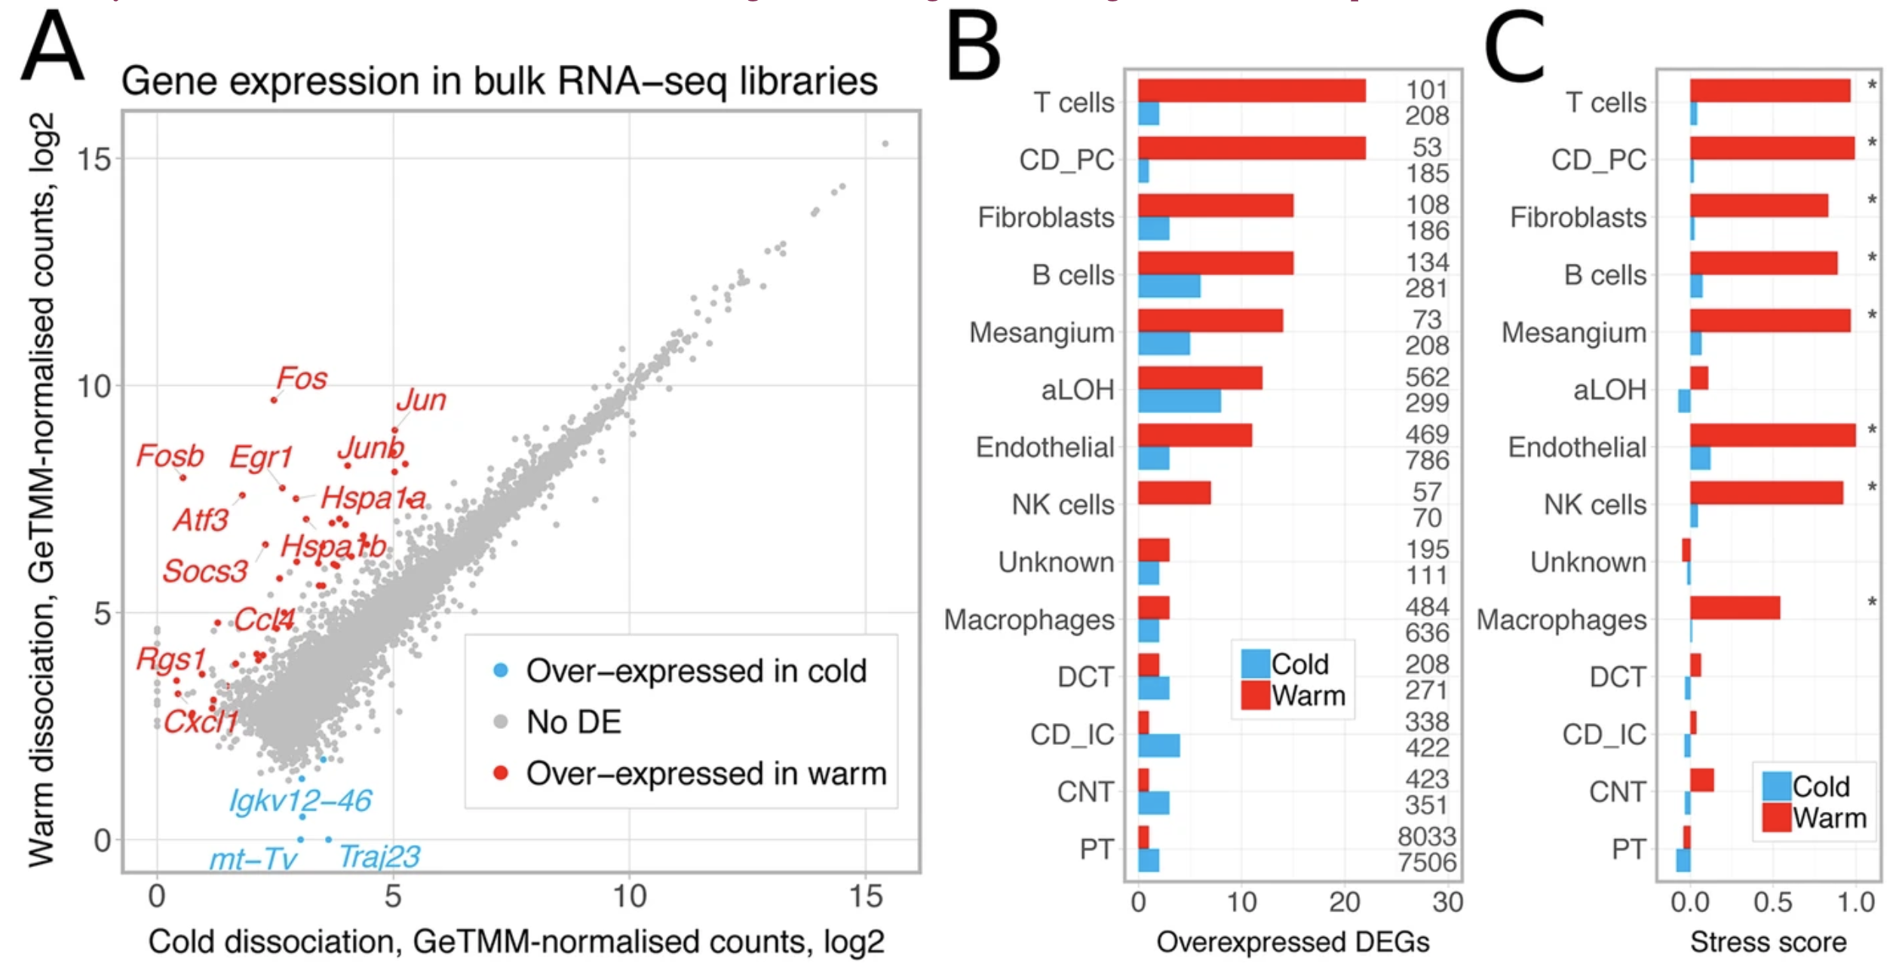
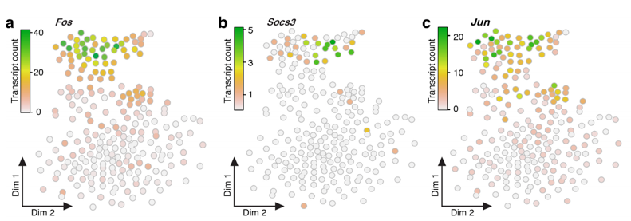
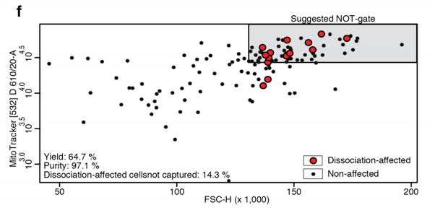
QC metrics – Dissociation Stress
Enzymatic treatment and suspension at 37C lead to induction of immediate-early genes (IEG)
Artifactual, post-dissociation transcription (and degradation) can obscure underlying transcriptome

Slide 41
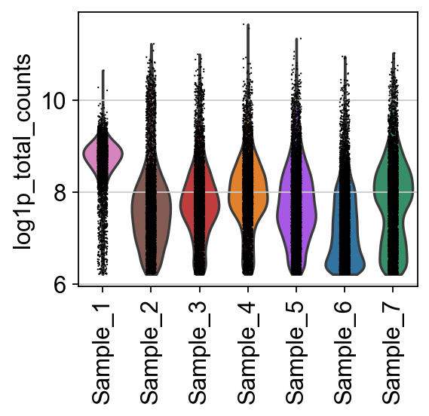
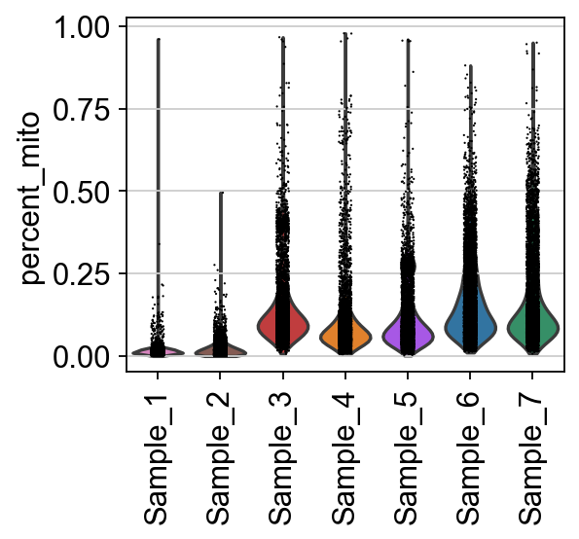
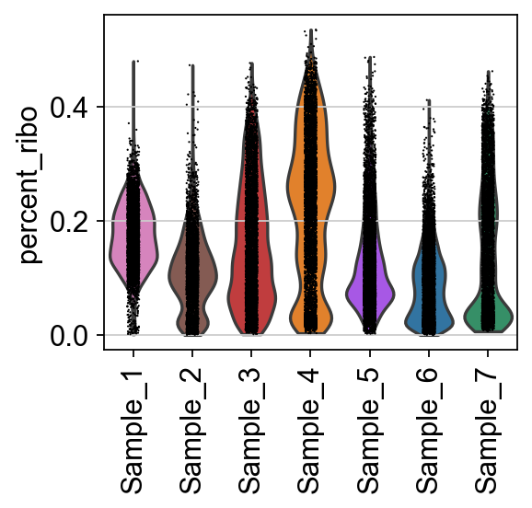
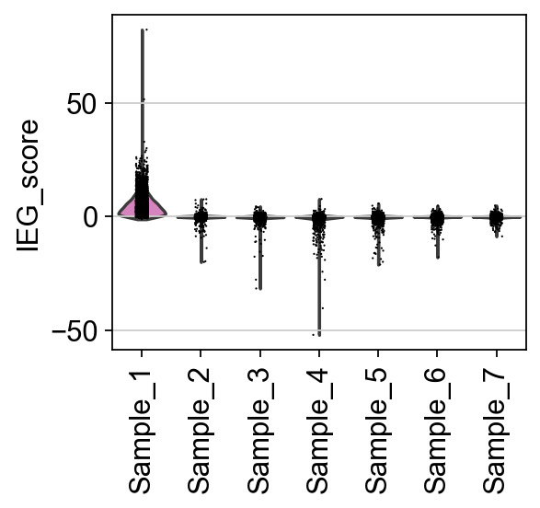
QC metrics
don’t always correspond to artifacts
UMI counts:
Cell types
Viability
Sequencing depth
Library handling
Mitochondrial %
Dying cells
Respiration activity!
(some cells have > 50% but are alive!)
Immediate-Early Genes
Post-dissoc. stress
In vivo acute activation
Ribosomal %
Cell types
Activation / Metabolism
Sequencing depth
(normalization artifact)

Slide 42
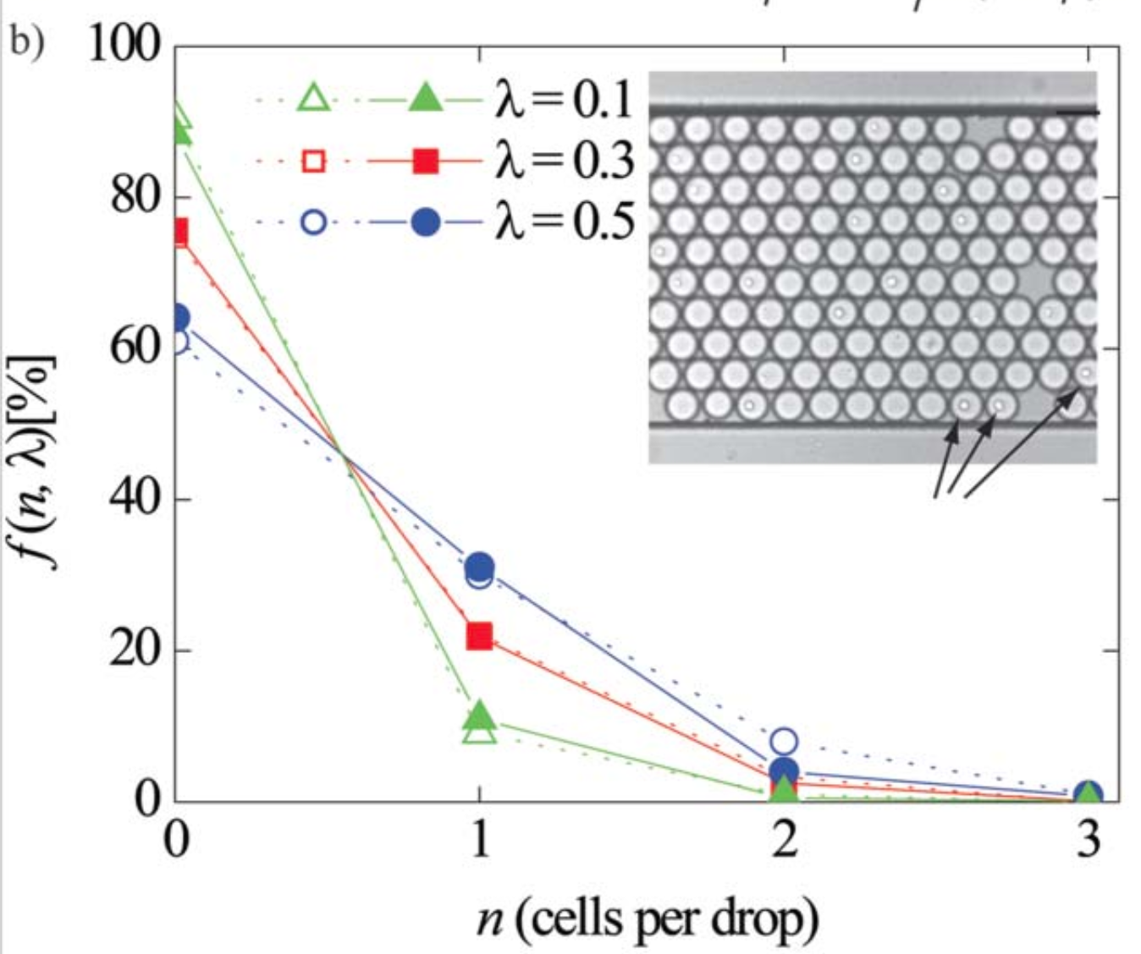


Doublets / Multiplets
Köster…Weitz. Lab on a Chip (2008)

Slide 43



Doublet Filtering
Scrublet
DoubletFinder - [R] - Doublet detection in single-cell RNA sequencing data using artificial nearest neighbors. BioRxiv
DoubletDecon - [R] - Cell-State Aware Removal of Single-Cell RNA-Seq Doublets. [BioRxiv](DoubletDecon: Cell-State Aware Removal of Single-Cell RNA-Seq Doublets)
DoubletDetection - [R, Python] - A Python3 package to detect doublets (technical errors) in single-cell RNA-seq count matrices. An R implementation is in development.
Scrublet - [Python] - Computational identification of cell doublets in single-cell transcriptomic data. BioRxiv
Wolock et al. (2018) bioRxiv

Slide 44



Uses Variational Bayes Inference
Similar to Latent Dirichlet Allocation (LDA)
Models soup as a weighted combination of other cell types in the population

Slide 45



Normalization & log transformation
Basic Method:
Gene(i)Counts
All Gene Counts
* 10,000 (ie. transcripts per 10k, “tp10k”)
Alternatively, though less commonly:
* 1e6 (ie. transcripts per million, “tpm”)
Does not account for stochastic variation in droplet performance, batch, other noise
OR innate difference in UMI counts between cell types!
Other options, eg scran normalization
Add 1
Logarithmize
Basic variance stabilizing transformation
Other options:
Arcsin(h)
SCTransform (Seurat)
Pearson residuals
http://bioconductor.org/packages/release/bioc/html/scran.html

Slide 46




Feature Selection: Highly Variable Genes (HVGs)
Assumption: genes that are interesting in the data will have higher variance
Count-based RNAseq data has higher variance with higher expression (mean-variance relationship)
Thus, different approaches to select HVGs exist to select relevant HVGs to account for their expression ‘bin’
Alternatively: do PCA on ALL genes (computationally intensive)
Cell
Ranger
Seurat
Seurat
v3

Slide 47


Feature Selection: Supervised gene sets
Siha cervical cancer cell line
529 curated cell-cycle genes
Macosko et al. (Cell) 2015 May 21; 161(5): 1202–1214.
PCA, UMAP
~1D circular manifold!

Slide 48





Linear Regression of Unwanted Variation
Fit a linear model of each gene’s expression vs confounder variable
Eg. cell cycle gene score, % mito, dissociation-stress response, library size
Take model residuals as new scaled values
This often doesn’t work well.

Slide 49


Principal Component Analysis
NOT a dimensionality reduction method, per se. It is a ROTATION.
Identifies linear combinations of genes that explain the most variation in the data
PCs ~ analogous to gene expression programs
PCs are orthogonal (gene expression programs might not be)
Zero-center data (subtract mean)
Scale Uniformly (ie. Z-score by gene)
Produce covariance matrix
Eigen decomposition
Singular value decomposition
PC2
PC1
Cool interactive visualization
https://setosa.io/ev/principal-component-analysis/

Slide 50



How Many PCs?
Option 1:
Jackstraw analysis: Determine “significant” PCs
Randomly permute data & recalculate PCs
Compare “Real” PCs with random noise.
-slow
-still subject to weakness of PCA
Option 2:
Elbow Plot
Option 3:
Pick a number that gives you results that you can interpret and defend.

Slide 51






PC “Loadings”
Semi-interpretable as gene expression signatures
Check what they contain
Eg. PC3 here is correlated with Sample → Batch effect?

Slide 52
Other means of Dimensionality Reduction
Deep Learning
scVI
scVAE
SAUCIE
VASC
DCA
scvis
scSemiGAN
Linear Transformation
PCA
ICA
Matrix Factorization
NMF
CoGAPS
HPF
Model-based
ZIFA
Ensemble
SIMLR
… any many, many more
Most methods seek to find a latent / embedding space that is biologically interpretable
Adapted from Xiang e al. Front Genet. doi: 10.3389/fgene.2021.646936.

Slide 53

Deep Learning methods: Autoencoders
Batch correction
Denoising
Non-linear mapping of latent space (gene programs)
Tran et al. Nat Commun. 2021 Feb 15;12(1):1029. doi: 10.1038/s41467-021-21312-2.

Slide 54



Training set of handwritten numbers
2D Latent-space representation
“0 / 6”-ish
Closed circles
“1 / 7 / 9”-ish
Straight lines
“3 / 5 / 8”-ish
”bumpy”

Slide 55




Variational Autoencoders
Stable Diffusion
Rombach et al. High-Resolution Image Synthesis with Latent Diffusion Models. arXiv:2112.10752
scGEN

Slide 56


Towards sharable and reproducible embeddings
Using generative, deep-learning based models
Project your own data into shared embedding
transfer cell type labels
Eg. Sfaira (Theis lab)
Online ‘zoo’ of hundreds of datasets and models
Fischer, D.S., Dony, L., König, M. et al. Sfaira accelerates data and model reuse in single cell genomics. Genome Biol 22, 248 (2021). https://doi.org/10.1186/s13059-021-02452-6

Slide 57


Visualization with tSNE/UMAP
T-distributed stochastic neighbor embedding
Uniform Manifold Approximation
Non-linear dimensionality reduction best suited to visualization
PCA space → Neighbor Graph →
Not a good way to cluster cells
But clusters should correlate visually
Very Similar Algorithms
tSNE runs a normalization on
distance graph in PCA space, UMAP doesn’t
tSNE favors fine / local structure
UMAP “smooths” clusters, favors global structure
Speed: UMAP >> tSNE
Proximity roughly corresponds to similarity
tSNE
UMAP

Slide 58

No one projection is “correct”

Slide 59


Clustering
Generally run on latent space (eg. PC space)
Built into Cell Ranger, most 3rd party tools:
K-means:
Ask algorithm to break data into ‘K’ optimally distinct clusters
Usually run iteratively over a range of ‘K’ based on expectations of cell types, state, etc in data
Graph-Based (eg. Louvain or Leiden Modularity Optimization)
Compute all pairwise Euclidean distances in latent space
Trim graph only keep each cells ‘K’ nearest neighbors* (k
“kNN Graph”
Draw boundaries around “communities” of connected cells to optimize modularity (in-group connections vs out-group connections)
Variants: Shared Nearest Neighbors, Weighted Nearest Neighbors
*(Completely unrelated to K in K-means!)

Slide 60



Clustering Resolution
Resolution parameter tunes clustering sensitivity
Optimal clustering is subjective
Guided sub-clustering may provide best result s
Ie. globally changing resolution parameter may nicely identify meaningful subtypes of one kind of cell, while breaking others into meaningless arbitrary blobs.
Note: Clustering is probabilistic: reproducibility requires manually setting a random seed!
High resolution
Too Low: miss subtypes, phenotypic states
Too High: over-clustered, no meaningful distinguishing marker genes

Slide 61


Batch Correction:
Harmony
“Batch” corresponds to global differences resulting from:
Samples run on different days
Samples run in by different people / labs
Samples handled slightly differently
Order of sample processing
Chemistry differences (kit version, 3’ vs 5’), etc.
Good batch correction will find a joint latent space that prioritizes and aligns intra-sample distances
Often only operates on latent dimensions / clustering. Most approaches not not directly modify data matrix
ie. often can’t be used for differential expression
“The best batch correction happens at the bench” –J Preall
Harmony: Korsunsky, I., Millard, N., Fan, J. et al. Nat Methods 16, 1289–1296 (2019).
Benchmarking: Tran, H.T.N., Ang, K.S., Chevrier, M. et al. Genome Biol 21, 12 (2020). https://doi.org/10.1186/s13059-019-1850-9

Slide 62
Controlling for batch effects
WT
KO
Ambient RNA in droplets
Significant sources of
contaminating mRNA:
Differential expression between ”empty” droplets:
 | Erythrocytes
WT: | Epithelial
 | Granulocytes
KO: | Acinar cells
Ctrl
KO

Slide 63


Ambient RNA: ”SOUP”
Droplet # 1 2 3 4
Cell
Lysis
Emulsion
Soup →
Read counts
Computational methods to mitigate (but not totally fix) Soup:
SoupX
DecontX
Cellbender
The best time to fix Ambient RNA problems is at the bench!
Proportion of droplet reads

Slide 64

SoupX
Young and Behati (bioRxiv) 2018.
https://www.biorxiv.org/content/10.1101/303727v1

Slide 65
Uses Variational Bayes Inference
Similar to Latent Dirichlet Allocation (LDA)
Models soup as a weighted combination of other cell types in the population

Slide 66



Variational Inference method
GPU-optimized
Corrects 2 problems:
Soup / Ambient RNA
Barcode swapping during PCR

Slide 67





Getting started with your own analyses
Rahul Satija - NYGC
R
https://satijalab.org/seurat/
Fabian Theis - München
R
Liger
R
https://scanpy.readthedocs.io/en/latest/
Python
Macosko lab
Cole Trapnell –WashU
AWESOME SINGLE CELL RESOURCE
https://github.com/seandavi/awesome-single-cell

Slide 69


Differential Gene Expression
Popularity
Performance vs ‘Ground Truth’ datasets
Seurat:
Default: Wilcoxon
Many other tests built in
Scanpy:
Default: t-test
use scDE or other plugins for additional tests
Cell Ranger:
Defaults: Exact Negative Binomial (low cell counts)
EdgeR NB (high cell counts)
Squair, J.W., Gautier, M., Kathe, C. et al. Confronting false discoveries in single-cell differential expression. Nat Commun 12, 5692 (2021). https://doi.org/10.1038/s41467-021-25960-2

Slide 70


Differential Gene Expression
Single-cell methods biased towards highly expressed genes
Pseudobulk methods make fewer false discoveries of highly expressed genes
(ie. bin clusters or similar cells to reduce zeros and control for high variance in highly expressed genes)
Squair, J.W., Gautier, M., Kathe, C. et al. Confronting false discoveries in single-cell differential expression. Nat Commun 12, 5692 (2021). https://doi.org/10.1038/s41467-021-25960-2

Slide 71

Cell Type Identification
2019
Name | Version | Language | Underlying classifier | Prior knowledge | Rejection option | Reference
Garnett | 0.1.4 | R | Generalized linear model | Yes | Yes | [14]
Moana | 0.1.1 | Python | SVM with linear kernel | Yes | No | [15]
DigitalCellSorter | GitHub version: e369a34 | Python | Voting based on cell type markers | Yes | No | [16]
SCINA | 1.1.0 | R | Bimodal distribution fitting for marker genes | Yes | No | [17]
scVI | 0.3.0 | Python | Neural network | No | No | [18]
Cell-BLAST | 0.1.2 | Python | Cell-to-cell similarity | No | Yes | [19]
ACTINN | GitHub version: 563bcc1 | Python | Neural network | No | No | [20]
LAmbDA | GitHub version: 3891d72 | Python | Random forest | No | No | [21]
scmapcluster | 1.5.1 | R | Nearest median classifier | No | Yes | [22]
scmapcell | 1.5.1 | R | kNN | No | Yes | [22]
scPred | 0.0.0.9000 | R | SVM with radial kernel | No | Yes | [23]
CHETAH | 0.99.5 | R | Correlation to training set | No | Yes | [24]
CaSTLe | GitHub version: 258b278 | R | Random forest | No | No | [25]
SingleR | 0.2.2 | R | Correlation to training set | No | No | [26]
scID | 0.0.0.9000 | R | LDA | No | Yes | [27]
singleCellNet | 0.1.0 | R | Random forest | No | No | [28]
LDA | 0.19.2 | Python | LDA | No | No | [29]
NMC | 0.19.2 | Python | NMC | No | No | [29]
RF | 0.19.2 | Python | RF (50 trees) | No | No | [29]
SVM | 0.19.2 | Python | SVM (linear kernel) | No | No | [29]
SVM_{rejection} | 0.19.2 | Python | SVM (linear kernel) | No | Yes | [29]
kNN | 0.19.2 | Python | kNN (k = 9) | No | No | [29]
A hard problem
What even is a cell type?
Who is curating these?
Cell types versus states
normal vs disease / perturbed
What type of model is being used?
Marker-based
Reference dataset label transfer
https://www.scrna-tools.org/tools?sort=name&cats=Classification
MANY more tools available
Abdelaal, T., Michielsen, L., Cats, D. et al. A comparison of automatic cell identification methods for single-cell RNA sequencing data. Genome Biol 20, 194 (2019). https://doi.org/10.1186/s13059-019-1795-z

Slide 72






Atlas Efforts building Cell Type Classifiers

Slide 73
Going Beyond Gene Expression
Copy Number Inference:
InferCNV: Tirosh et al (2016) Science doi: 10.1126/science.aad0501
KopyKAT: Gao R et al. (2021) Nat Biotechnol. doi: 10.1038/s41587-020-00795-2
Alternative TSS Utilization:
scRCAT-seq: Hu Y et al (2020) Nat Commmun. 10.1038/s41467-020-18976-7
Alternative Polyadenylation:
scAPA: Shulman et al (2019) Nucleic Acids Res. doi: 10.1093/nar/gkz781
Sierra: Patrick et al (2021) Genome Biology. doi: 10.1186/s13059-020-02071-7
eQTL Analysis
Kang H et al. (2018) Nat Biotechnol. doi: 10.1038/nbt.4042
van der Wijst et al (2018) Nat Genet. doi: 10.1038/s41588-018-0089-9
Neavin et al (2021) Genome Biology. doi: 10.1186/s13059-021-02293-3
Alternative Splicing
Various methods involving long-read sequencing

Slide 74


CNV inference
”Normal”
Reference cells
Eg. inferCNV, CaSpER, CopyKAT, SCYN
Query Cells
Eg. Polyclonal
Cancer
Counts binned expression data across chromosomes
Builds a background model based on provided “Normal” reference
Identifies regions with higher than expected expression across entire window
Low resolution (multi-megabase) for scRNAseq
Can still resolve large-scale clonal copy number loss / gain in chromosome arms, etc.

Slide 75



Transcriptional Dynamics: RNA Velocity
Estimaties rates of change in mRNA levels by modeling nascent RNA synthesis
Quantifies spliced / unspliced
Models dynamics
CAVEATS: Gene annotations
Cryptic exons
unannotated intronic genes
repetitive elements
Le Manno et al. (2018) Nature

Slide 76


Bulk RNAseq from mouse circadian rhythm data

Slide 77


Cultured Cells – RNA Velocity
Siha (cervical epithelium cells)
Projected on to subspace using only cell-cycle relevant genes
RNA Velocity is relevant over very short time scales, when transition states are abundant in the population
S
G1
G2M
Latent time →

Slide 78


Caveat:
Don’t Confuse Developmental Trajectories with Cell Cycle Kinetics

Slide 79


SCENIC
single-cell regulatory network inference and clustering
Infers Transcription Factor Activity
Gene Co-expression network
Motif search
Regulon activity
Aibar et al. (2017) Nature Methods. SCENIC: single-cell regulatory network inference and clustering

Slide 80
SCENIC

